Slide 1





Slide 2
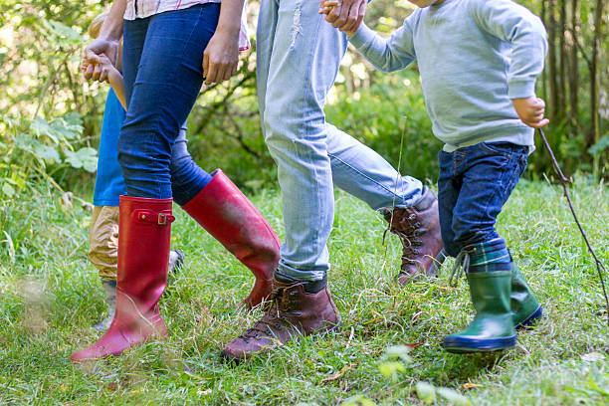
Leading as a co-journeyer

Slide 3
“... Just as a nursing mother cares for her children, so we cared for you. Because we loved you so much, we were delighted to share with you not only the gospel of God but our lives as well.”
1Thes 2:7-8

Slide 4
“Our work is not to pour information into our children, but instead to open a space for each child to discover their own understanding of God”

Slide 5

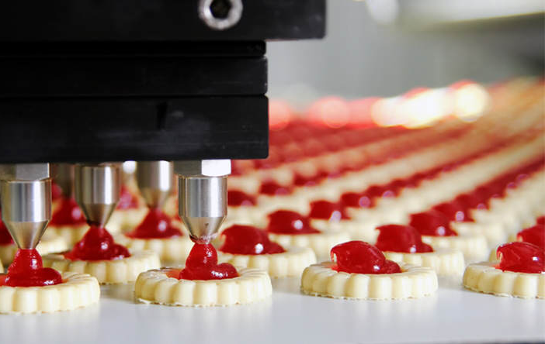
Content
and
Process

Slide 6
I wonder why this story is in the Bible?
I wonder what it would have been like to face that situation?
I wonder where you see yourself in this story?
I wonder what God is saying to you today through this story?
I wonder what it felt like to be….?
I wonder why God let that happen?
I wonder what this passage/story tells us about God’s character?

Slide 7
The discovery principle
People understand what you say
They remember what they say
They own what they discover
They act on what they own
(Jerome Burner)

Slide 8
Where can you see aspects of each paradigm in your ministry?
Which paradigm is dominant?
What is one thing you could change to make space for both content and process?

Slide 9
Practical Considerations
Environment
Space and Time
Listening
Questions
Experience
Activities
Your Story

Slide 10
As you think about these practical elements, what stands out for you? Why?
What is and area of strength in your context?
What is an area of development for you in your context?

