Slide 2
Missional Leadership is shaped by prayer.
To pray is to be in a relationship with God. It is in this place of relationship, that we discover and lean toward the heart of God for humanity, as seen in Matthew 28: 16 - 20. In this session, we’ll unpack these verses and how they direct our leadership, through an intimate relationship with God, that has a heart for humanity and the gospel.
Missional Leadership is shaped by prayer.
To pray is to be in a relationship with God. It is in this place of relationship, that we discover and lean toward the heart of God for humanity, as seen in Matthew 28: 16 - 20. In this session, we’ll unpack these verses and how they direct our leadership, through an intimate relationship with God, that has a heart for humanity and the gospel.

Slide 3
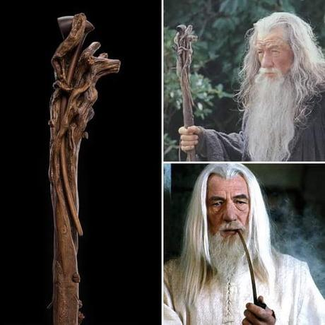

Slide 4
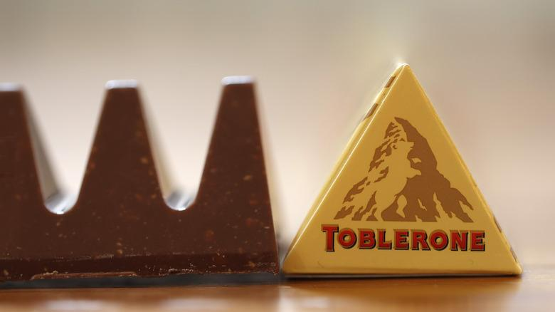

Slide 6
TAG

Slide 7
Your Mission…

Slide 8
Mission
Matthew 28: 16 – 20
Vs 16 – the disciples went to the mountain that Jesus told them to go…trust and obey.
Vs 17 – some worshipped, some doubted. (It is natural to worship him after all they had witnessed. Greek word denotes a state of uncertainty and hesitation, not unbelief.)
Vs 18 – Jesus came to them and spoke to them – All authority in heaven and earth had been given to him.
Vs 19 – Jesus tells them to go and make disciples of all nations, baptizing them in the name of the Father, Son, and Holy Spirit. The Trinity is involved in the gospel.
Vs 20 – teach them to observe all that Jesus has commanded. Jesus reiterates – I am with you to the end of the age.

Slide 9
Mission
Matthew 28: 16 – 20
How might what we see in these verses, shape our thinking and actions in light of our conversation about mission?
Could you make a summary statement or a note to yourself from these verses/words in bold?
I can trust and obey God, but I also acknowledge my humanness – it's ok to doubt and not be sure. However, I also acknowledge and walk in God’s authority as his ambassador, and I can therefore go, baptise, and disciple, remembering he is with me - always.
Is there one thing you can do, that moves you towards what you wrote down?

Slide 10
Leadership
Matthew 28: 16 – 20
vs 16 - the disciples obeyed an instruction from Jesus
vs 18 – Jesus is clear on his authority, his scope, and his mandate.
vs 19 – Jesus gives clear instructions: go…make…baptize…teach…
vs 20 – Jesus said “I am with you always…”
In light of this text, how might these verses direct your leadership? What do you need to tweak, adjust, upskill on etc?

Slide 11
Prayer
Matthew 28: 16 – 20
I wonder…
…if we truly trust God, with his mission of reconciliation, freedom, redemption and salvation.
…how much time we spend getting to know him and what’s on his heart for humanity.
…how we are discipling those in our teams to go deep in prayer and their walk with God, to build relationship, to build trust in who God is and what God is doing in our midst.
…if we grasp the authority of Jesus, that we pray in the name of Jesus and that we, as ambassadors, walk in his authority.

Slide 12
Prayer
Matthew 28: 16 – 20
To consider the above…
…our prayers become hope-filled prayers for God to do what only God can do!
…it gives us hope in what we do – for God sends us to do what only he can do which is spiritual awakening, opening the eyes and ears of the spiritually dead!
…it challenges us in the what to pray and the how to pray! We’re emboldened to pray…

Slide 13
Prayer
Matthew 28: 16 – 20
Luke Simmons
"A church planter friend recently confessed, “I believe in prayer but I bet on leadership.”
Convicting. Let's bet on prayer... and just see how God might lead."

Slide 14
Putting it all together
Matthew 28: 16 – 20
~ Does the mission, shape leadership and prayer? How?
~ Does leadership, shape mission and prayer? How?
~ Does prayer shape mission and leadership? How?
Why prayer needs to be the starting point of missional leadership – a conviction and a passion.
To pray is to be in a relationship with God. It is in this place of relationship, that we discover and lean toward the heart of God for humanity. This then, has a profound impact on our mission and leadership – the what we do and the how we do it.

