Slide 1
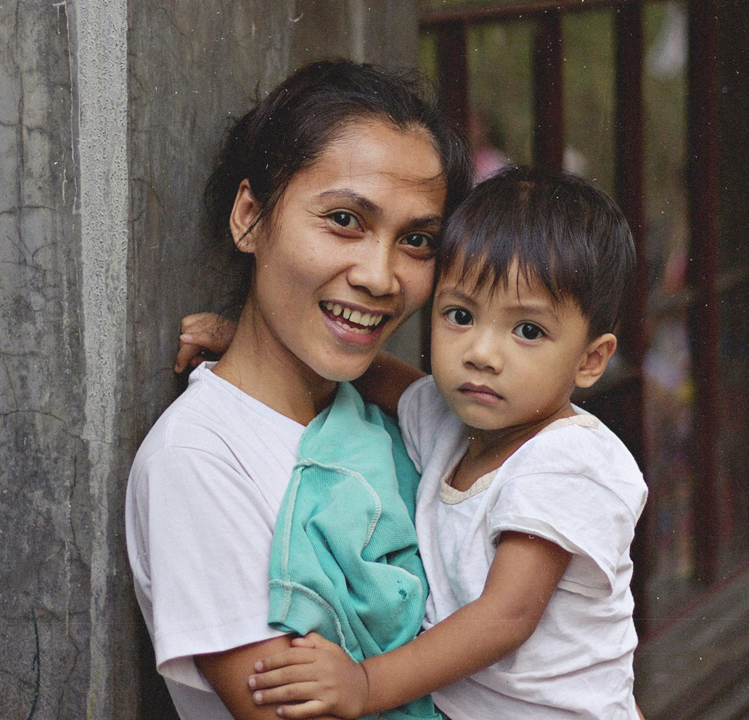
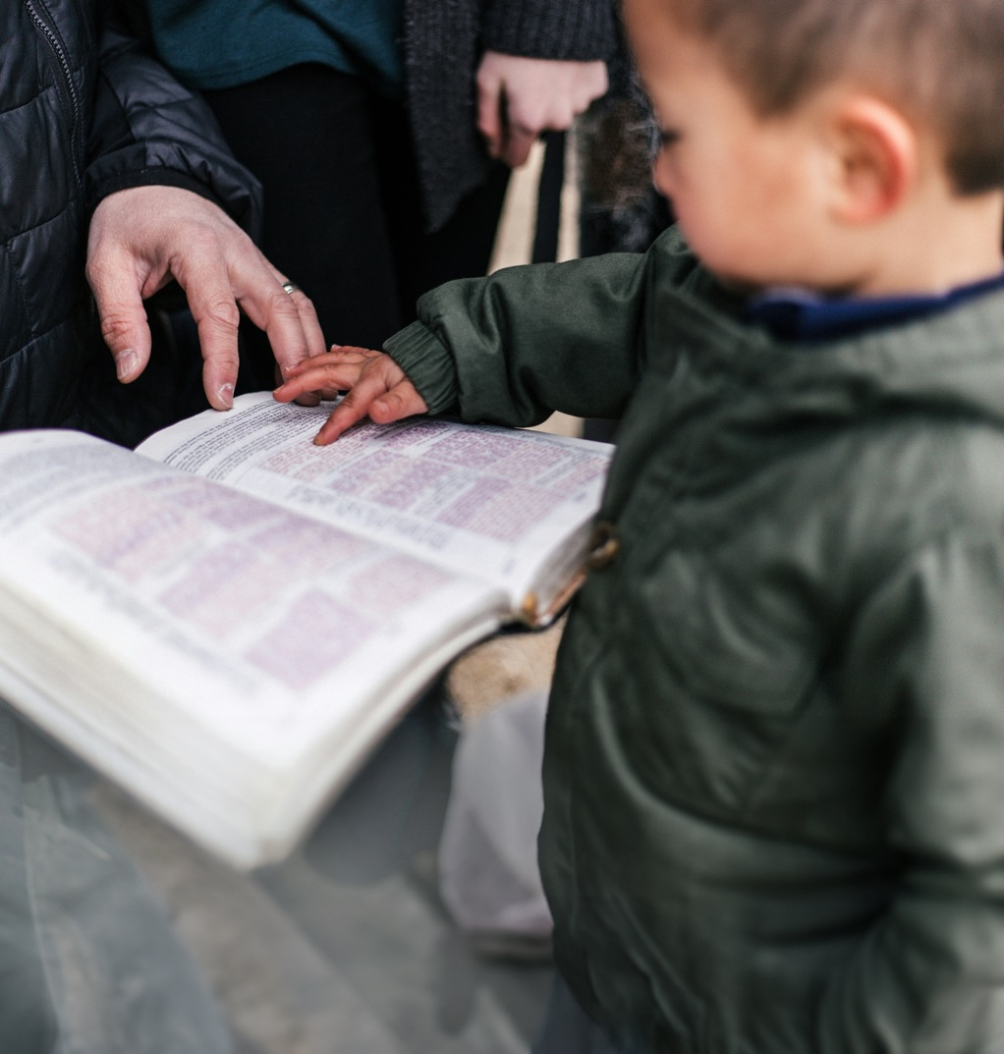

People mission connected

Slide 2
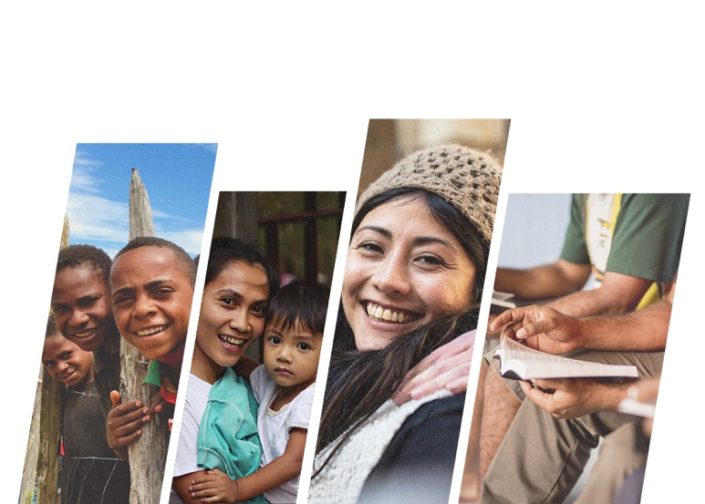
Global Connections
John and Wendy Buchanan
Mission Ambassadors
+64 6 882 9503
ambassador@gc3.org.nz

Slide 3

The Upside-Down Kingdom
for the Mighty One has done great things for me—
holy is his name.
His mercy extends to those who fear him,
from generation to generation.
He has performed mighty deeds with his arm;
he has scattered the proud in their inmost thoughts.
He has brought down rulers from their thrones
but has lifted up the humble.
He has filled the hungry with good things
but has sent the rich away empty.
Luke 1:49-53

Slide 4
The Upside-Down Kingdom
⁴² Jesus called them together and said, “You know that those who are regarded as rulers of the Gentiles lord it over them, and their high officials exercise authority over them. ⁴³ Not so with you. Instead, whoever wants to become great among you must be your servant, ⁴⁴ and whoever wants to be first must be slave of all. ⁴⁵ For even the Son of Man did not come to be served, but to serve, and to give his life as a ransom for many.”
Mark 10:42-45

Slide 5
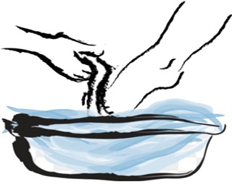
The Upside-Down Kingdom
The Servant Leader
What is a servant leader?
  Should we, like Jesus, wash the feet of other people?
    No… but we should humble ourselves and take on tasks that others would not expect us to do
  Should we, like Jesus, use whips to drive money changers from the temple (or whatever is today’s equivalent)?
    No… but we should stand against things that are “wrong”
Feel free to ask questions at any time along the way.

Slide 6

The Upside-Down Kingdom
The Servant Leader
What is a missionary?
  Someone who goes somewhere else to
  bring the good news of Jesus Christ?
  Someone who goes somewhere else to make disciples?
  Someone who does the above without
  going somewhere else?
Should a missionary be a servant leader?
  Yes? No? Why?
Instructions
Groups of 2-3 people
Discuss
Note your group’s answer(s)

Slide 7
We are all called to mission –
‘Here where we live or
there where we might go.’

Slide 8
The Upside-Down Kingdom
The Missionary as a Servant Leader
The missionary is a servant, not a ‘boss’
The missionary is a guest
The missionary earns the respect of the people he/she serves

Slide 9
The Upside-Down Kingdom
The Missionary as a Servant Leader
AUTHORITARIAN LEADERSHIP The Controlling Leader | SERVANT LEADERSHIP The Servant Leader
APATHETIC LEADERSHIP The Lost Leader | FAILED LEADERSHIP The Victim Leader
AUTHORITY
VULNERABILITY

Slide 10
The Upside-Down Kingdom
The Missionary as a Servant Leader
AUTHORITARIAN LEADERSHIP The Controlling Leader | SERVANT LEADERSHIP The Servant Leader
APATHETIC LEADERSHIP The Lost Leader | FAILED LEADERSHIP The Victim Leader
X
X
AUTHORITY
VULNERABILITY

Slide 11
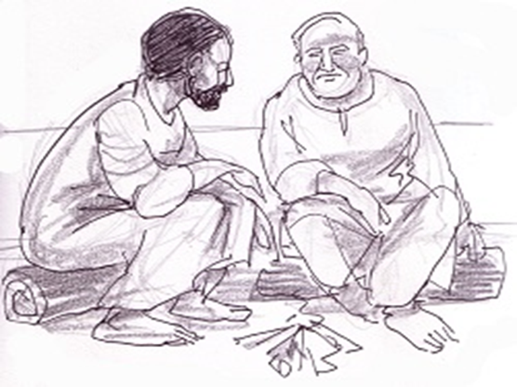
The Upside-Down Kingdom
The Missionary as a Servant Leader
AUTHORITARIAN LEADERSHIP The Controlling Leader | SERVANT LEADERSHIP The Servant Leader
APATHETIC LEADERSHIP The Lost Leader | FAILED LEADERSHIP The Victim Leader
Simon, son of John, do you love me?
X
X
AUTHORITY
VULNERABILITY

Slide 12
The Upside-Down Kingdom
Three cultures and the Iceberg Model
Three cultures:
Christian
Ours
Theirs

Slide 13

The Upside-Down Kingdom
Three cultures and the Iceberg Model
Behaviours
Visible
Three cultures:
Christian
Ours
Theirs
Personal Values and Attitudes
Less visible
Cultural Values and Assumptions
Not visible at all, rarely questioned

Slide 14
The Upside-Down Kingdom
The Servant Missionary – in a different culture 1
Western Missionaries in Africa…
Two features of African Culture:
Community: It is the community that believes, not just the individual.
Time: Africans look to the past for meaning, not to the future.
Instructions
Same as last time
Choose one.
If you didn’t know this, how might you do mission?
If you did know this, how might you do mission?

Slide 15
The Upside-Down Kingdom
The Servant Missionary – in a different culture 2
Western Missionaries (in general)
“Missionaries saw themselves as helping lower civilizations rise to become more civilized like them. The missionary calling was confused with the civilizing effort of Western nations.”
Jesus' mission was to make people like Jesus;
civilizing meant to make people like us.
“You have given your goods to feed the poor.
You have given your bodies to be burned.
We also ask for love. Give us FRIENDS.”
Ermias Mamo – In: The Maturing Church

Slide 16
The Upside-Down Kingdom
Culture – clashes and challenges
From a friend serving in South Asia…
“We were discussing cultural challenges to using a coaching approach in our South Asia context. This is very much a servant leadership approach – but…
the servant leader values the culture values
listening talking
asking telling
drawing out others directing
developing people holding power”

Slide 17
The Upside-Down Kingdom
Culture – Myanmar observations
Many Christian churches sing hymns
Ah na deh – “I can’t do it for you, but I also can’t tell you…”
Took us about 2½ years to be ‘heard’
“I want to be a servant leader, but I can’t get anything done unless I’m a dictator leader” (Quote from a Christian Leader)

Slide 18
The Upside-Down Kingdom
Influence
what I say
what I do

Slide 19

The Upside-Down Kingdom
The Missionary as a Servant Leader
– what to do/who to be
Humility and Love
Intimacy with and Faith in God
Acceptance of Diversity
Pursuit of Unity
Stewardship and Trustworthiness
What would you rate as your top two qualities?
Questions? Comments?

Slide 20


The Upside-Down Kingdom
Culture – 3 cultures again
Christian culture
Our culture
Their culture

Slide 21
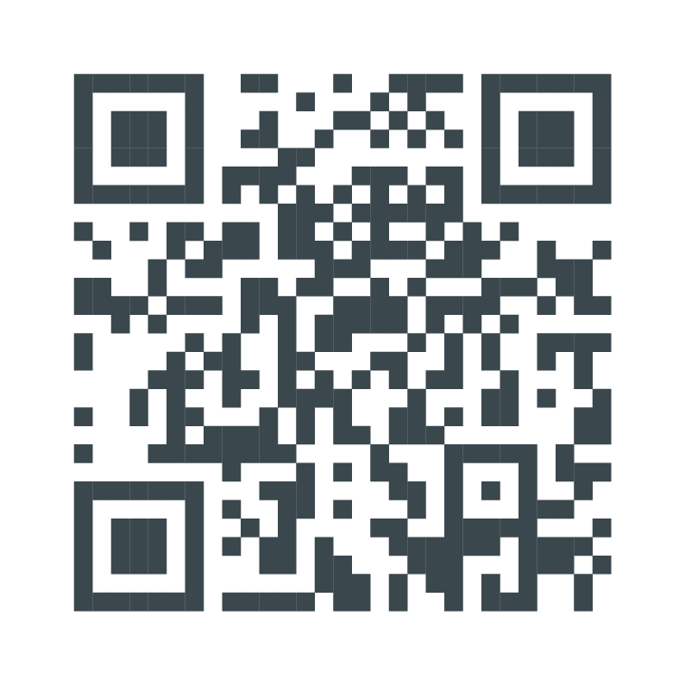
The Upside-Down Kingdom
Takeaways?
Pause…
Consider one takeaway for you
personally from this workshop
Feel free to chat with others…
gc3.org.nz/subscribe
Subscribe to e-Connect
weekly prayer newsletter

Slide 22
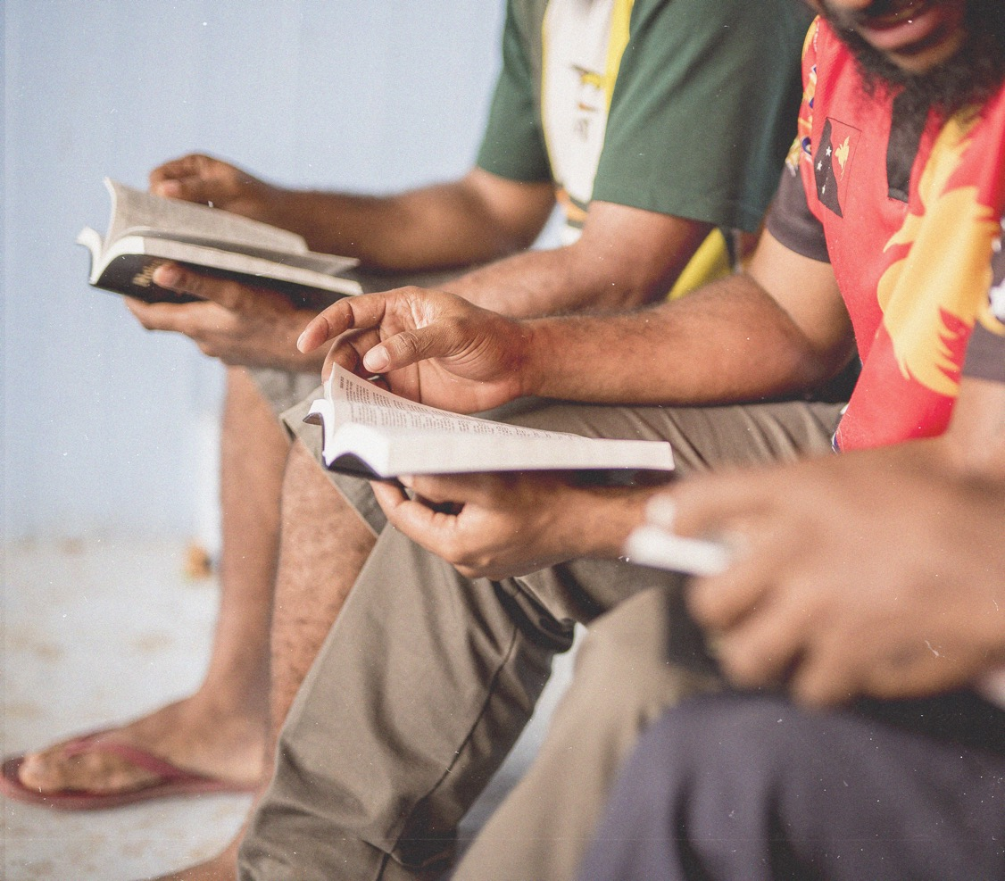
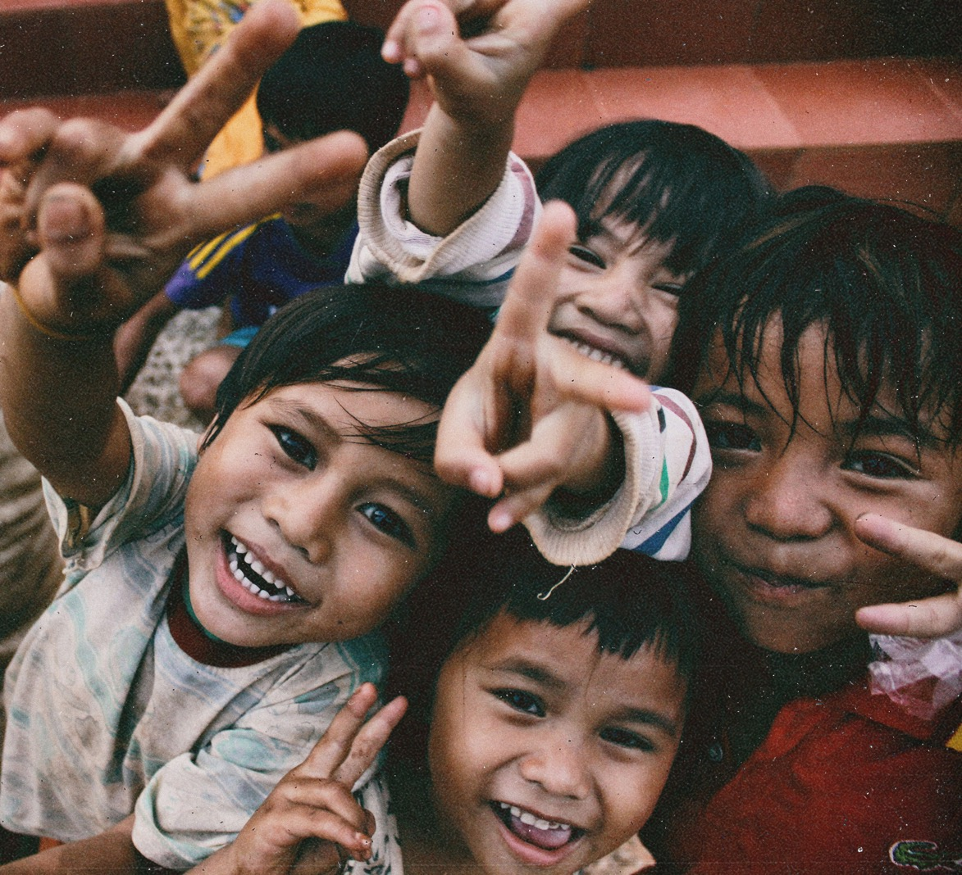
People mission connected

Slide 23
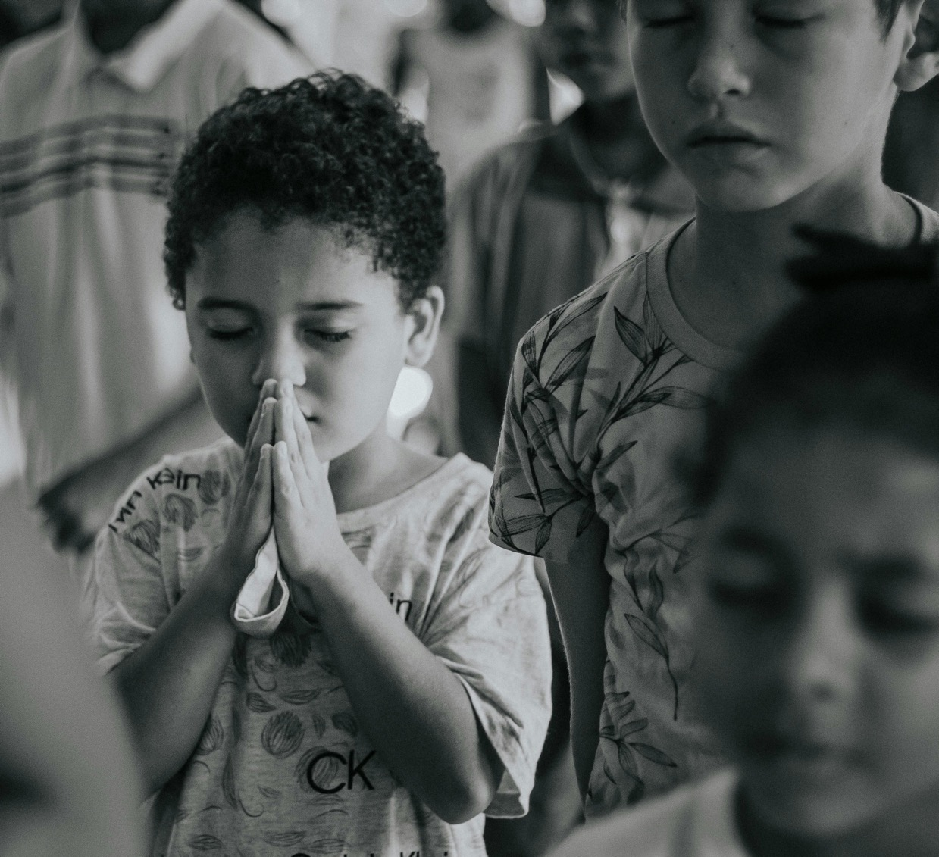
Subscribe to
e-Connect
weekly prayer newsletter
gc3.org.nz/subscribe

